Slide 1

Stack management
Flask web application

Slide 2
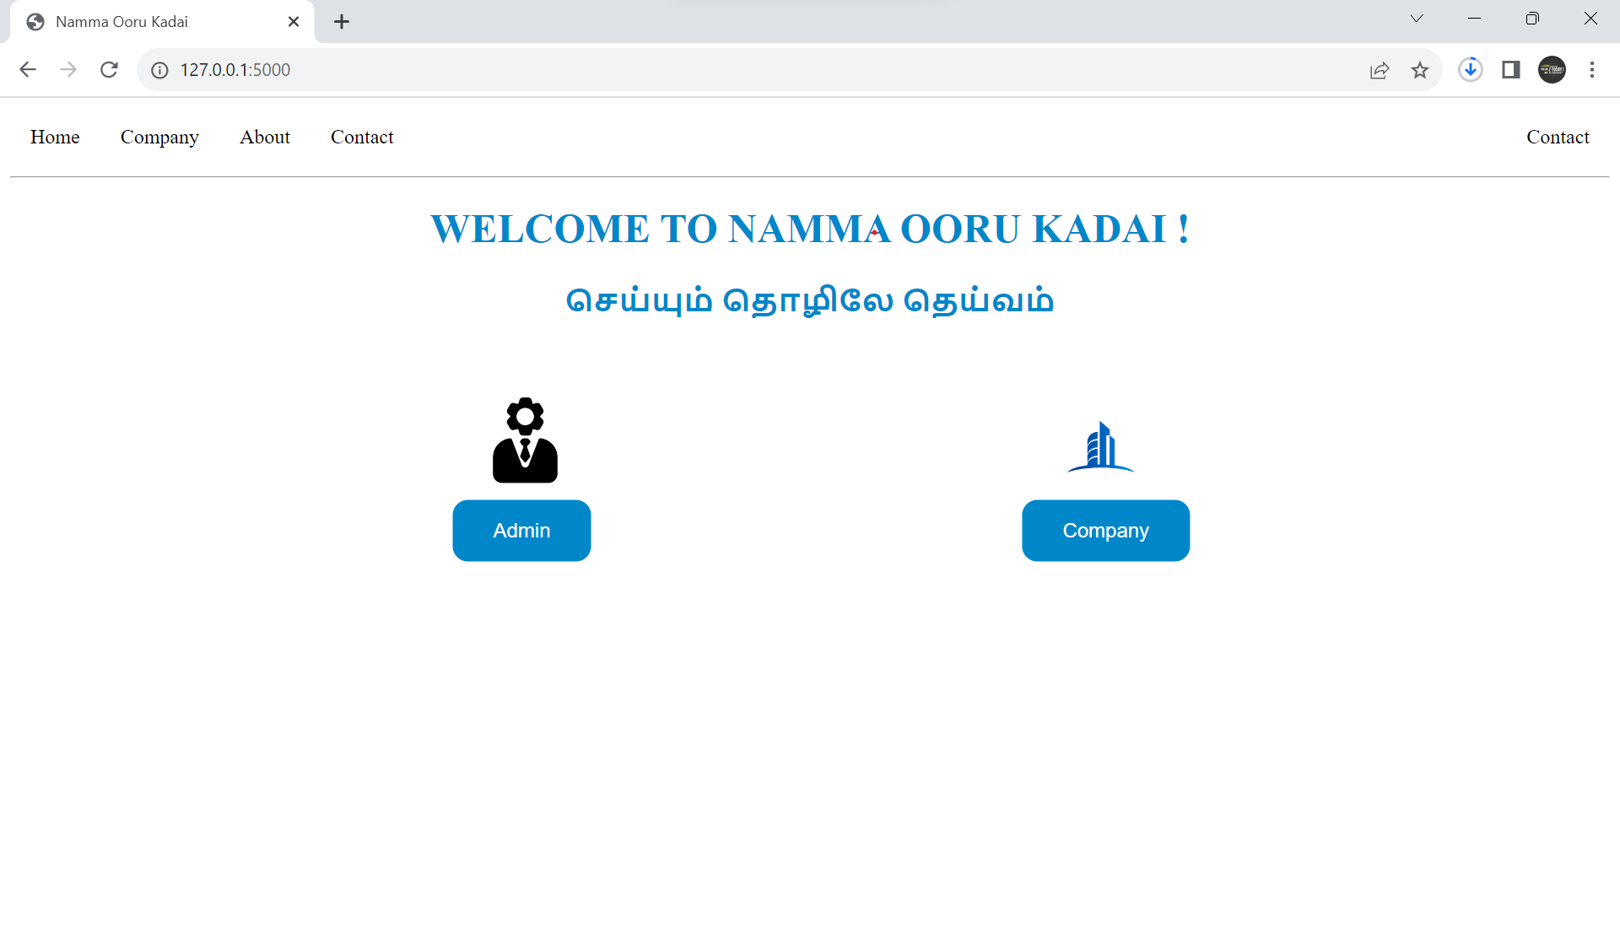
Home page

Slide 3
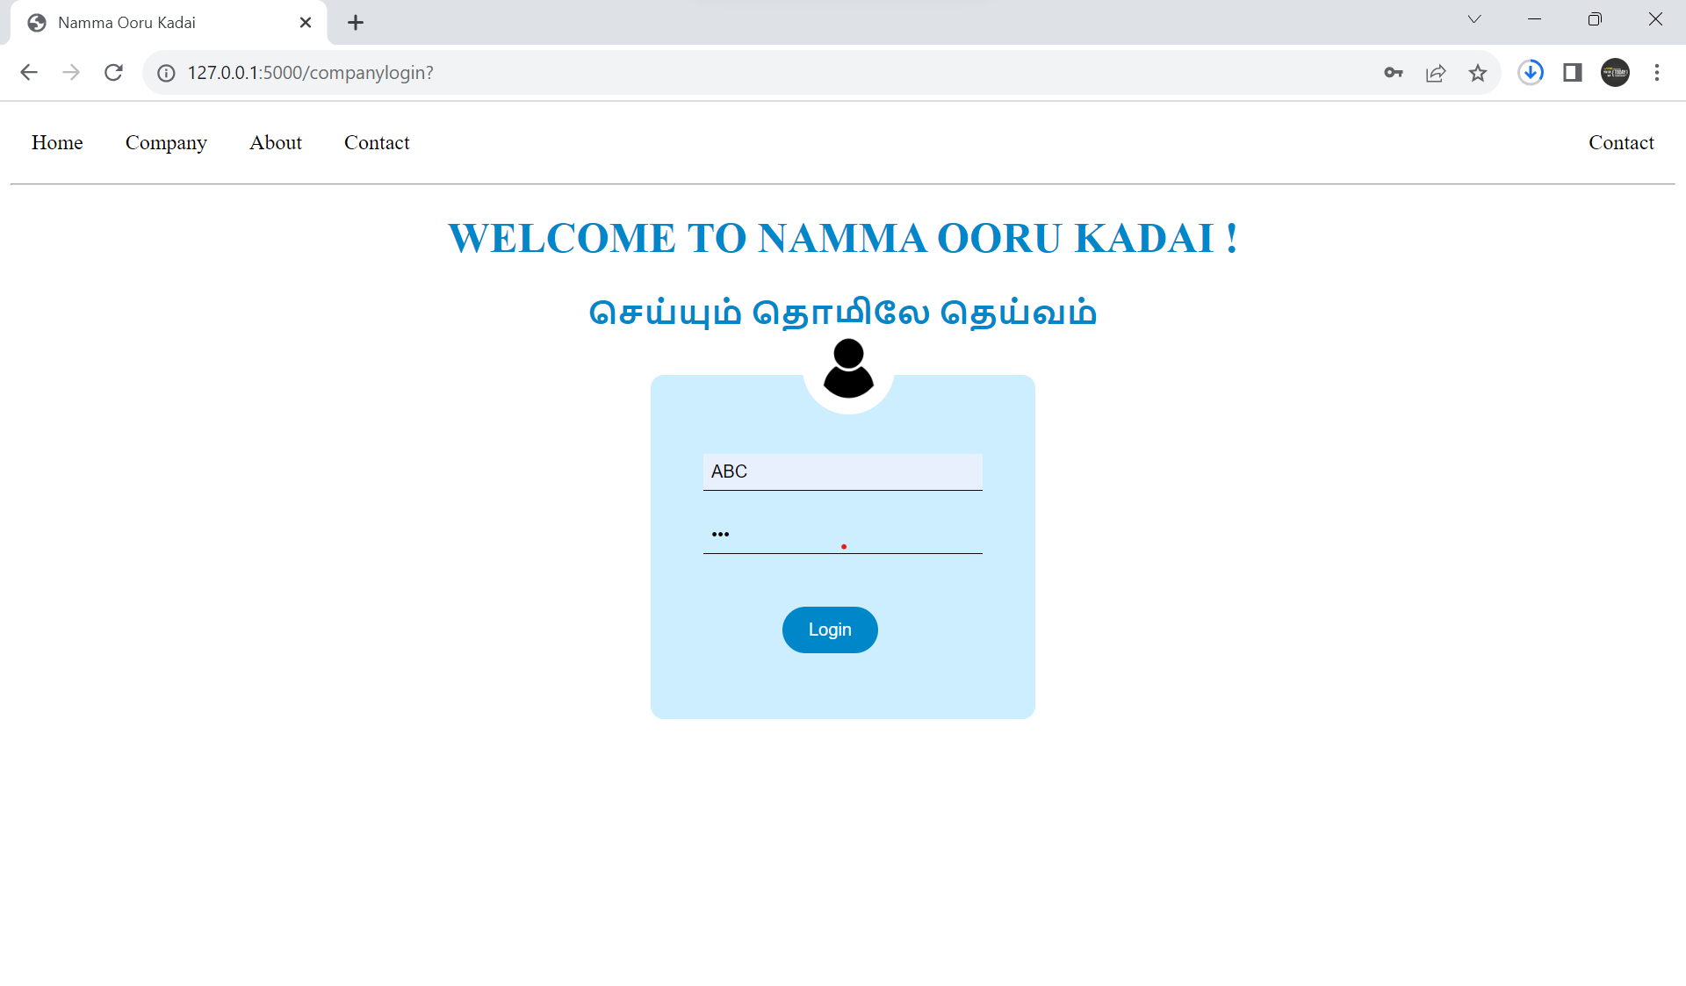
Company login

Slide 4
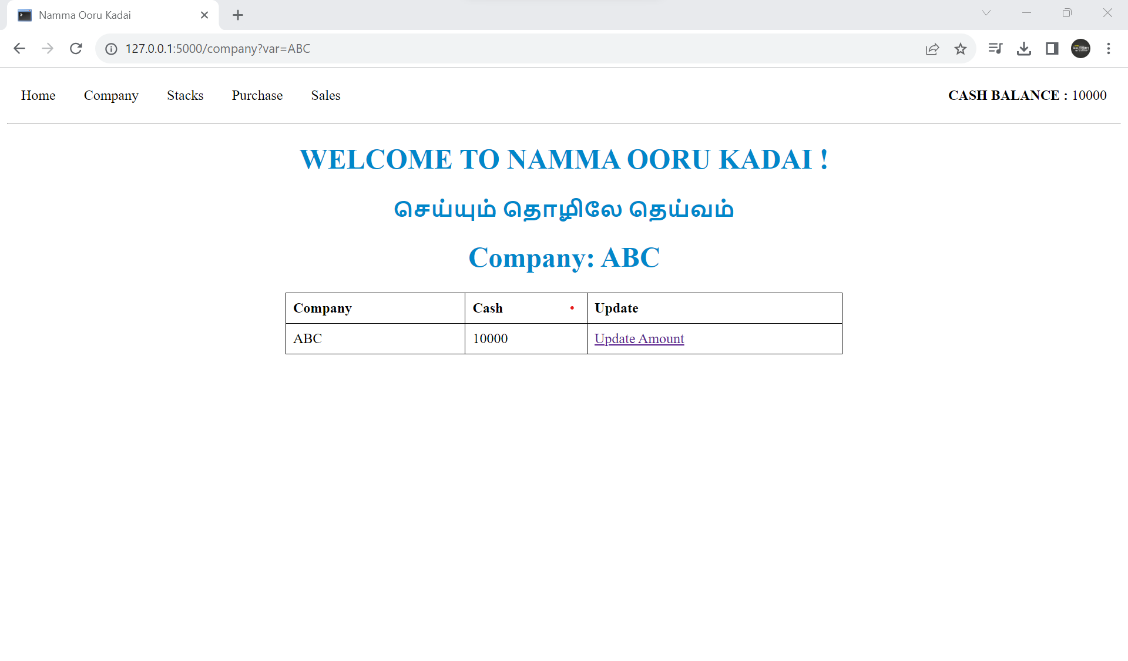
Company dashboard

Slide 5
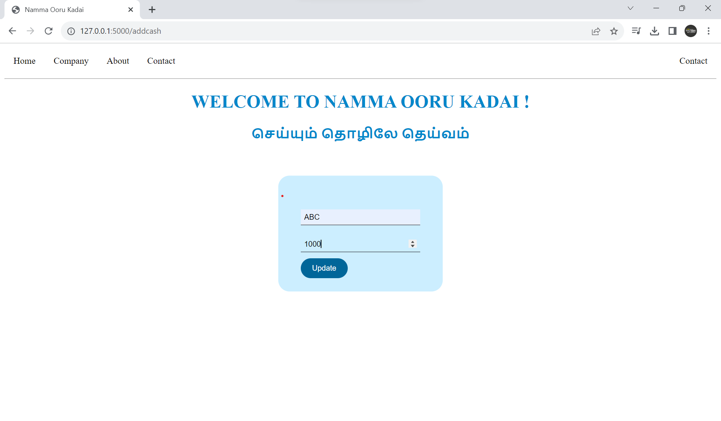
Update cash balance

Slide 6
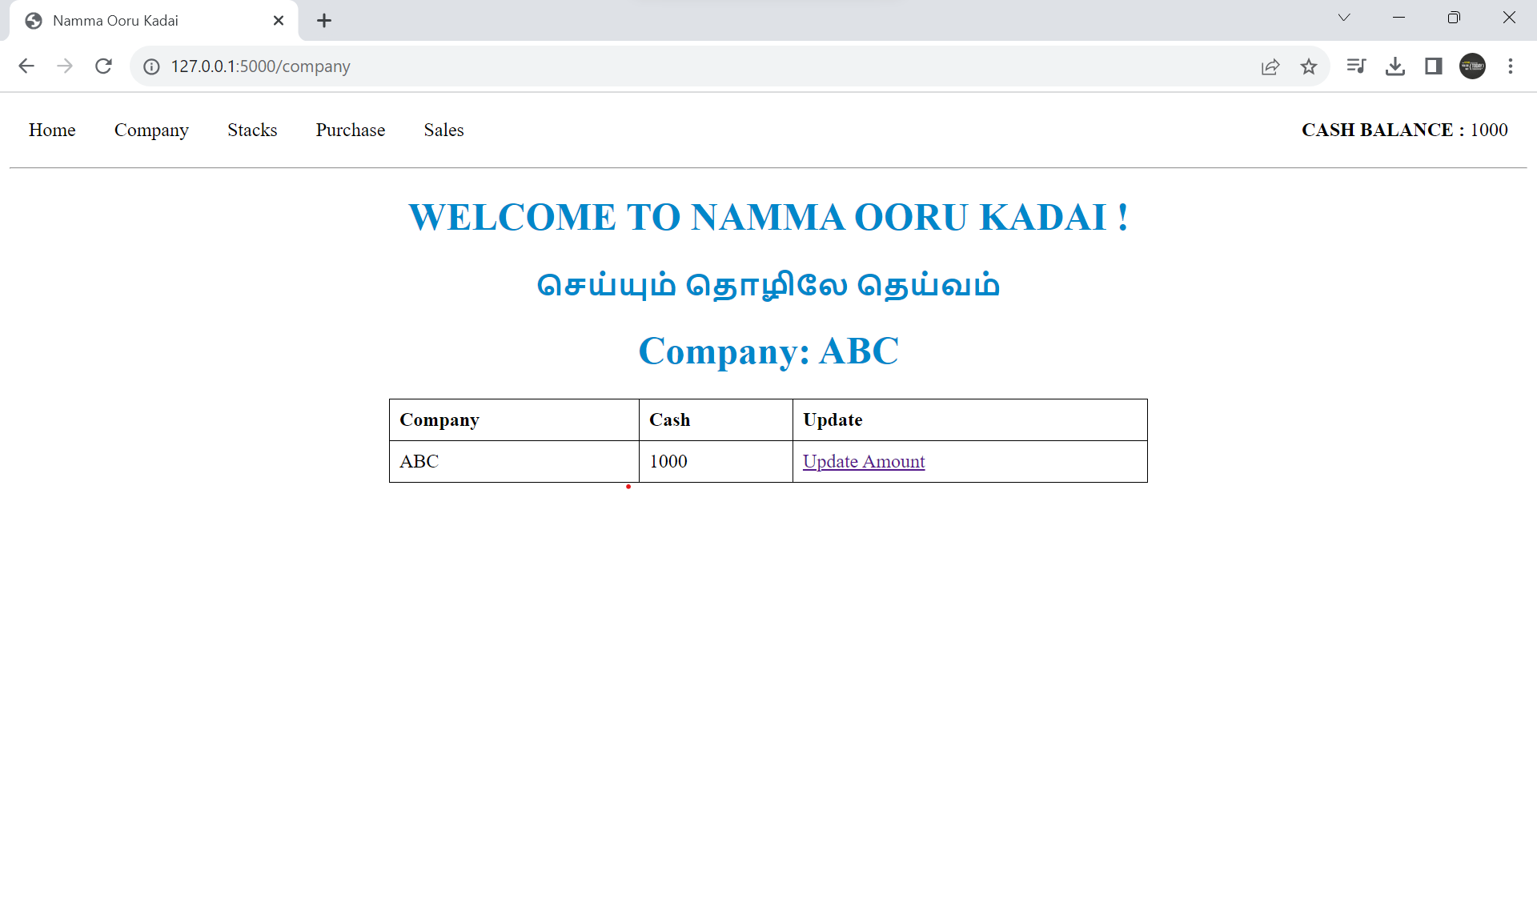
Updated cash balance

Slide 7
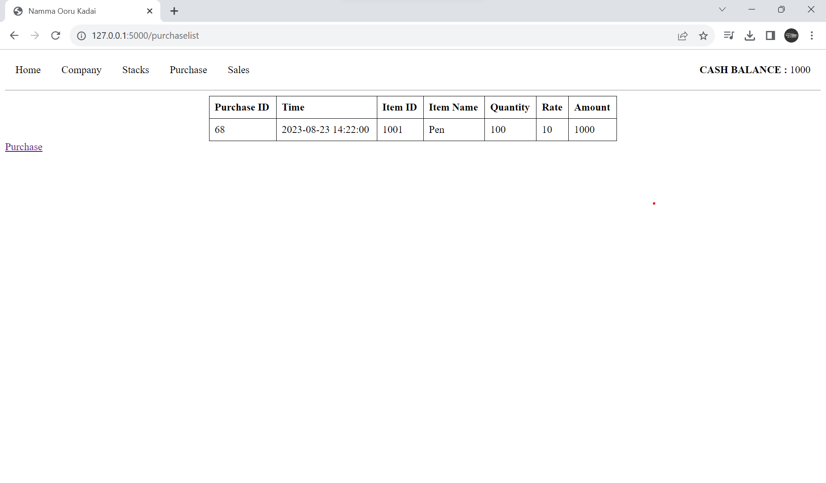
Purchase list

Slide 8
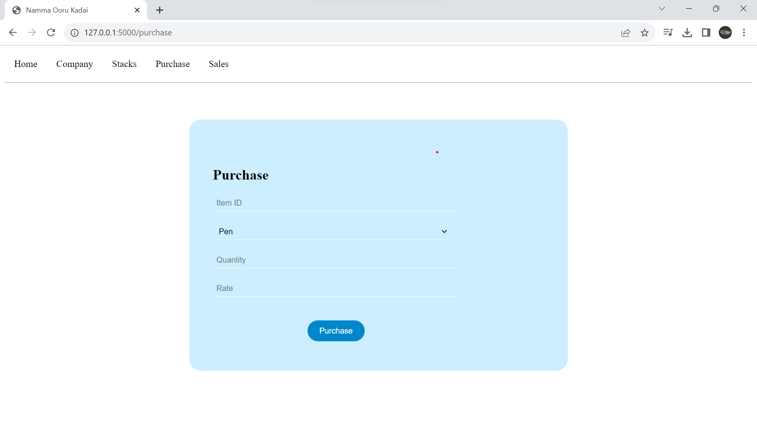
New purchase

Slide 9
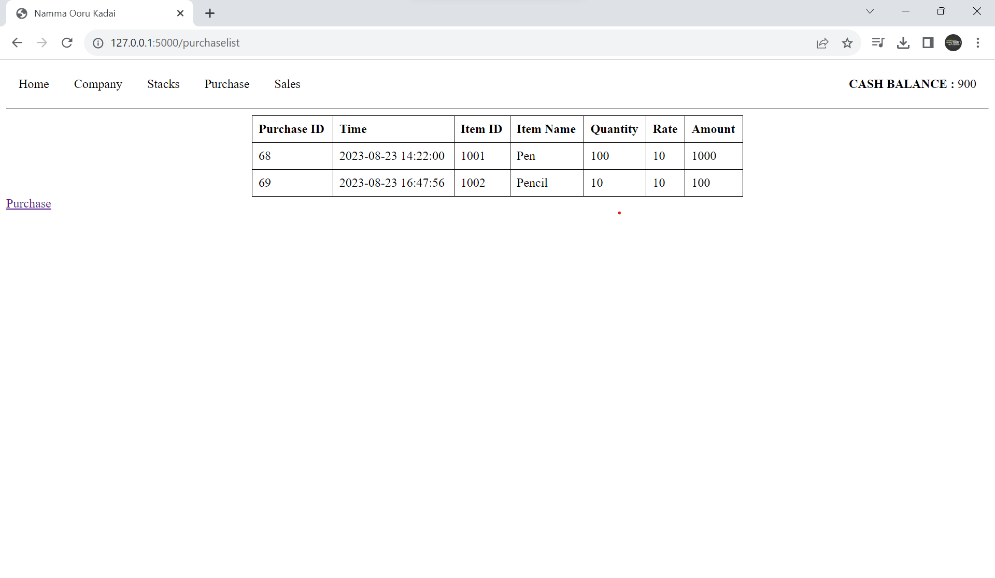
Updated purchase list

Slide 10
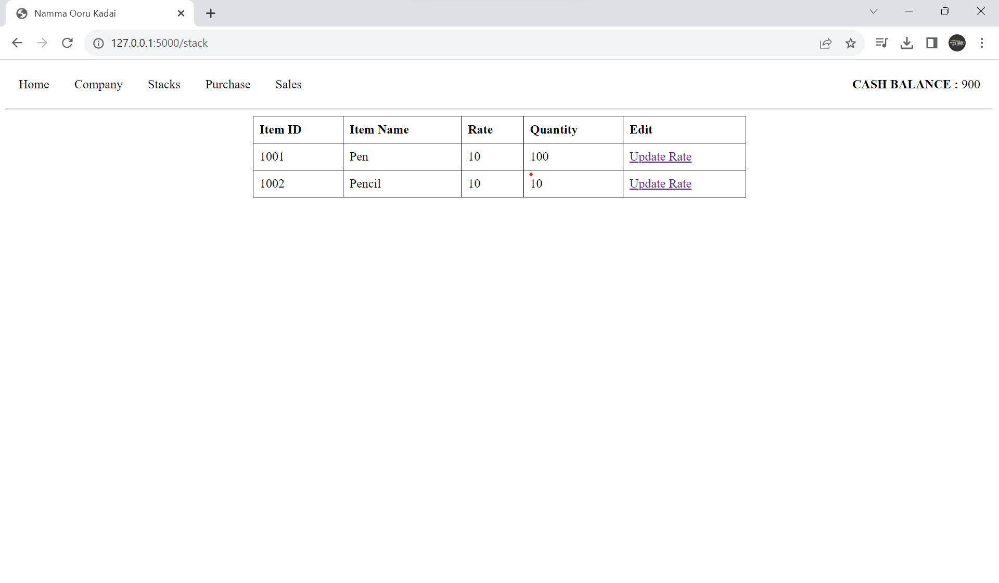
Stock list

Slide 11
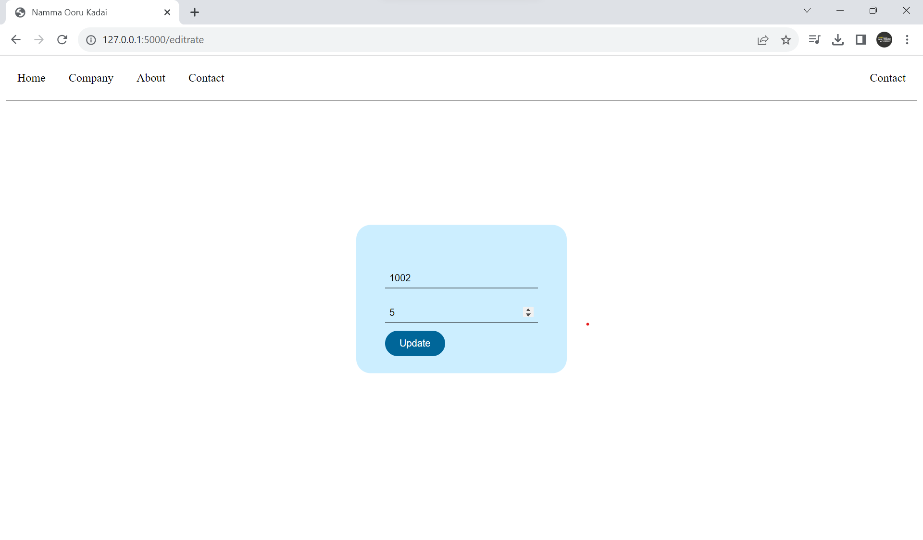
Edit rate in stock for selling

Slide 12

Updated stock list

Slide 13
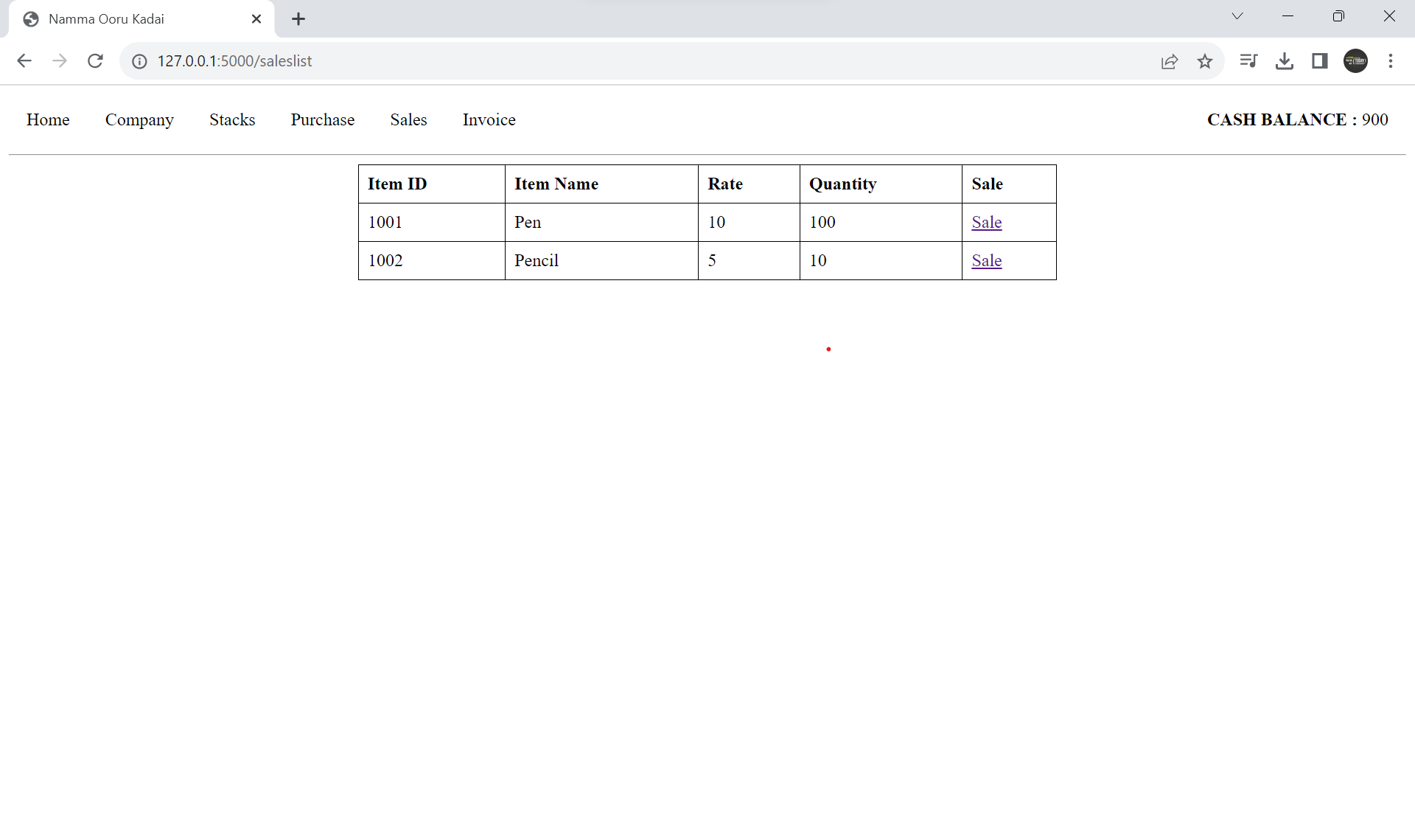
Stocks available for sales

Slide 14
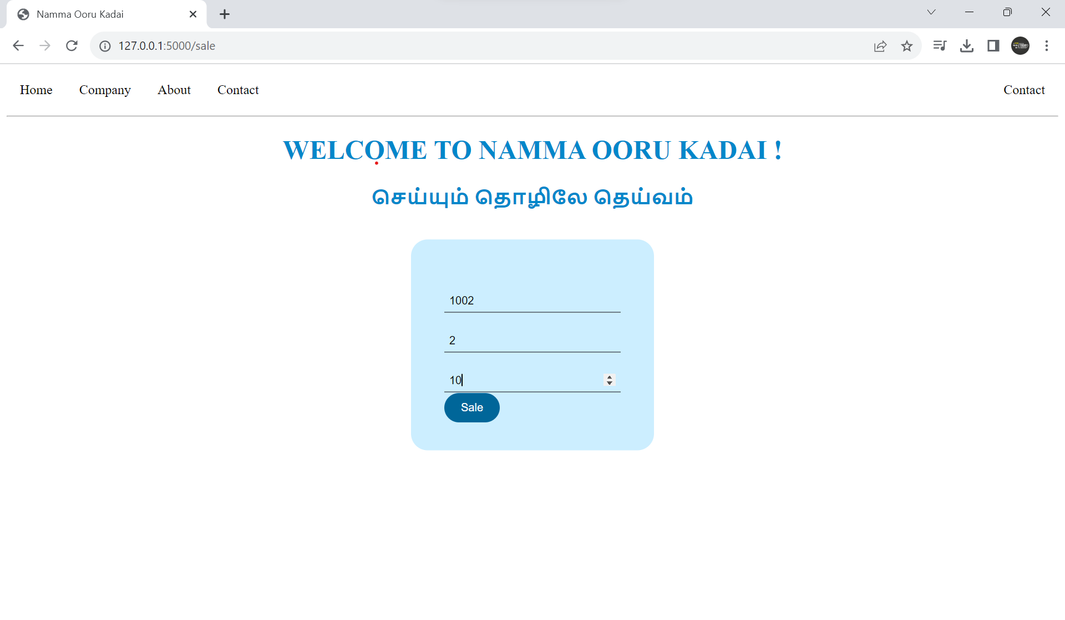
Selling item

Slide 15
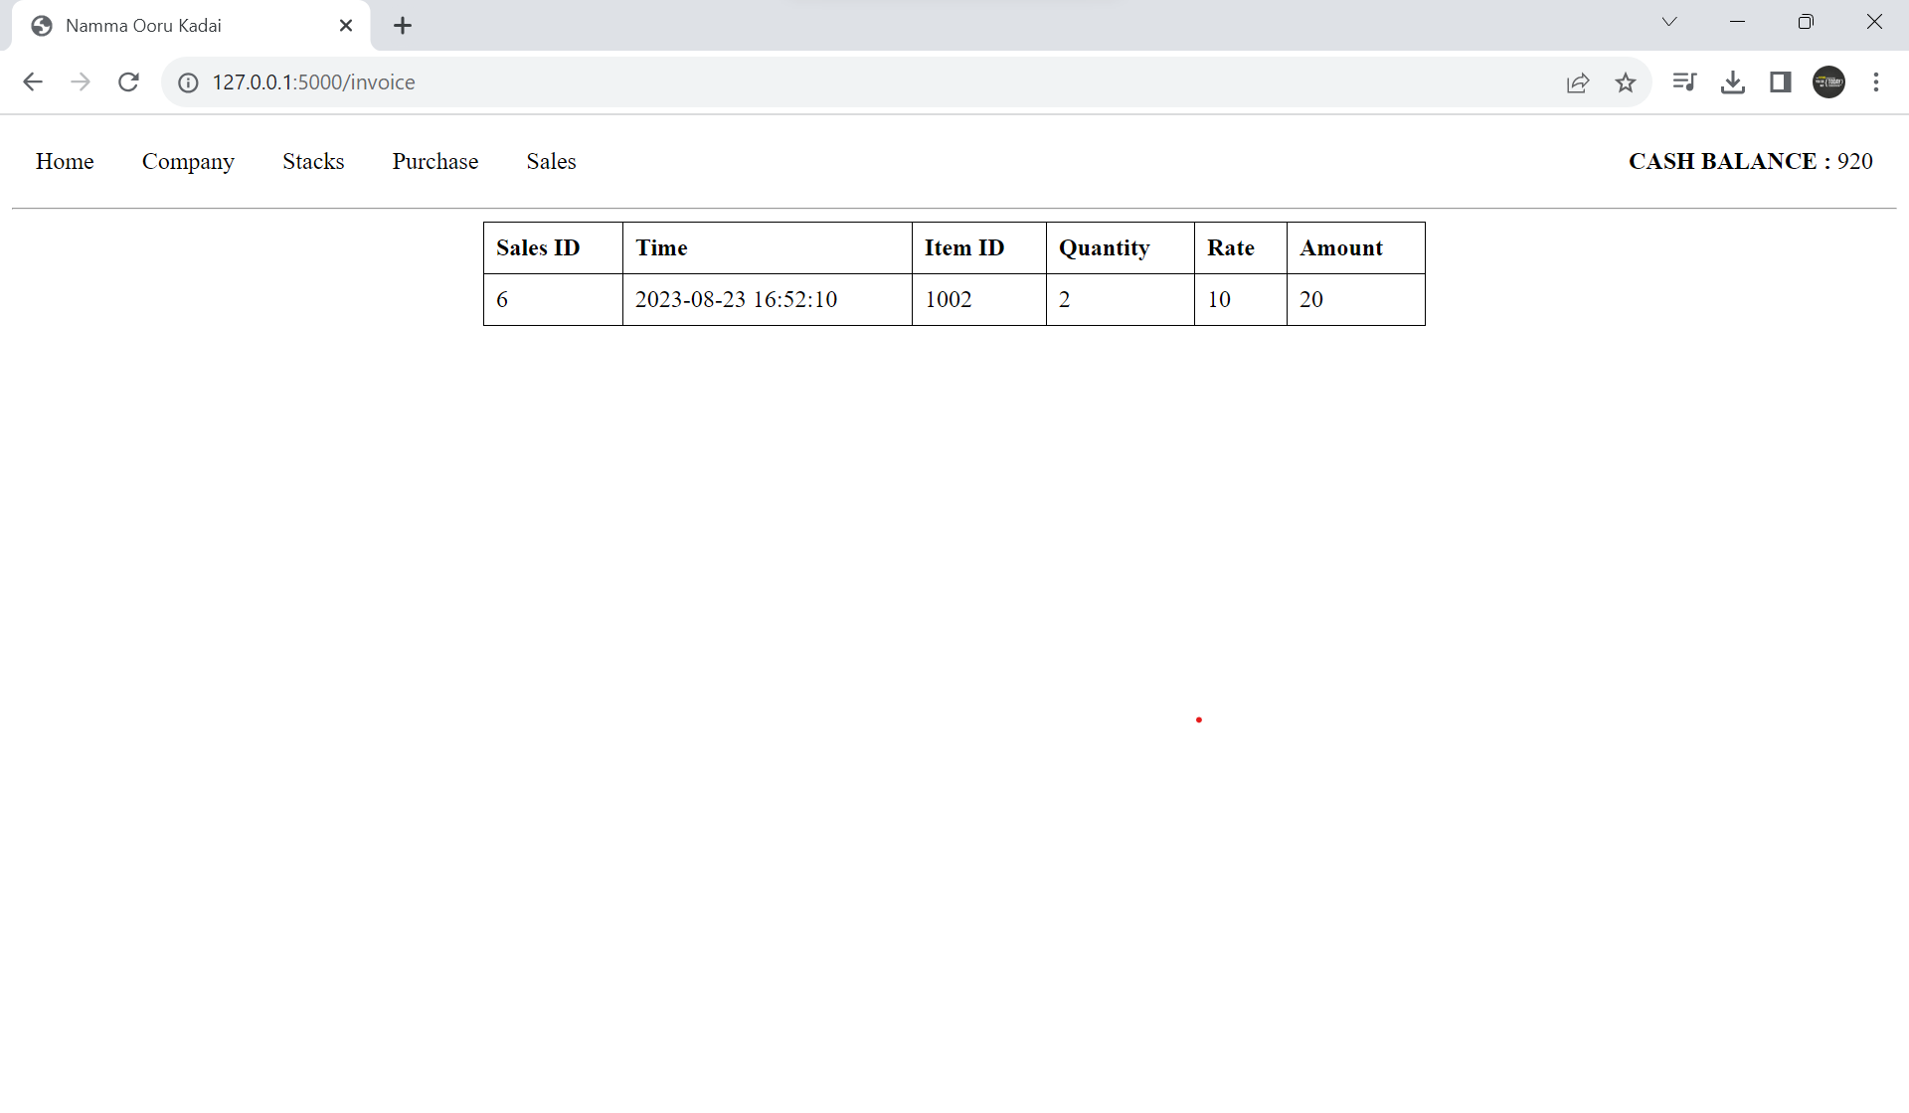
Sale invoice

Slide 16

Updated stock

Slide 17
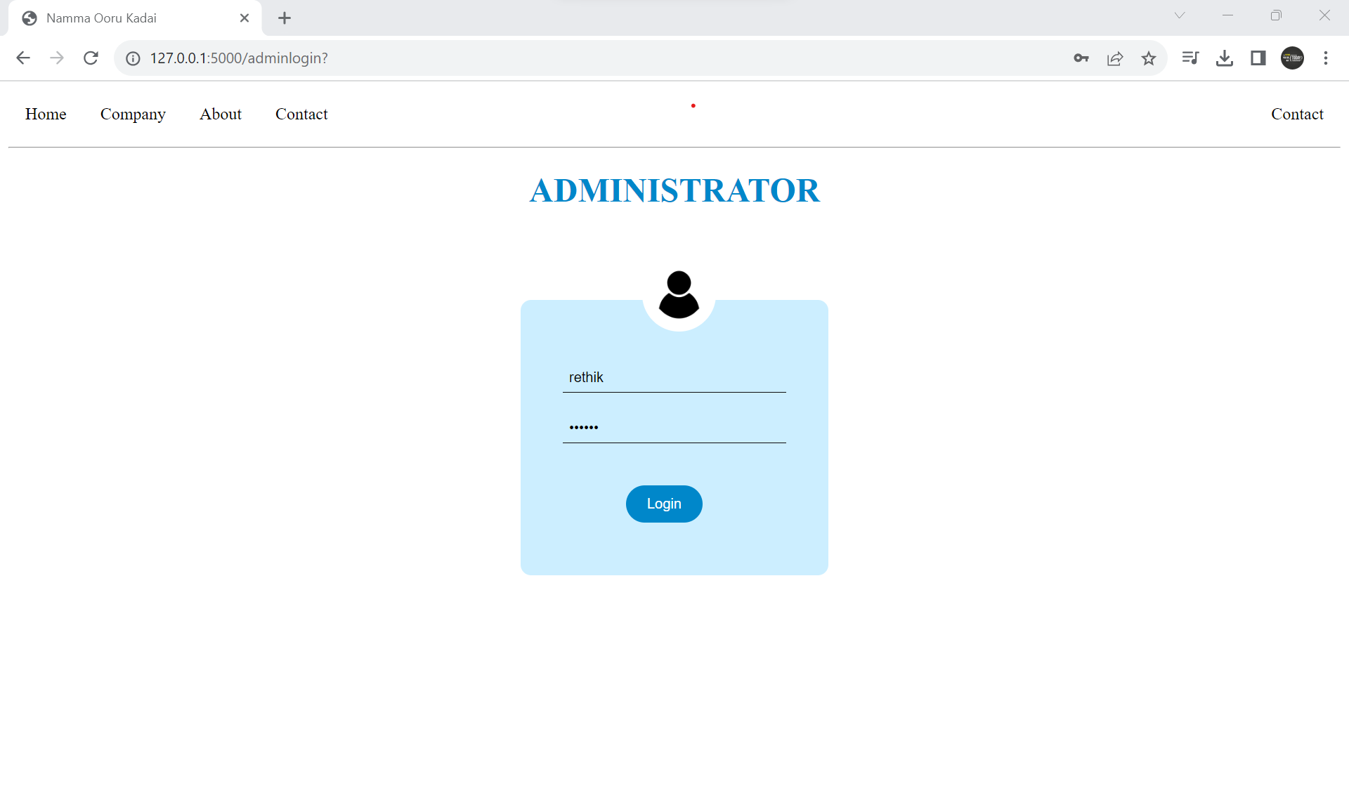
Administrator login

Slide 18
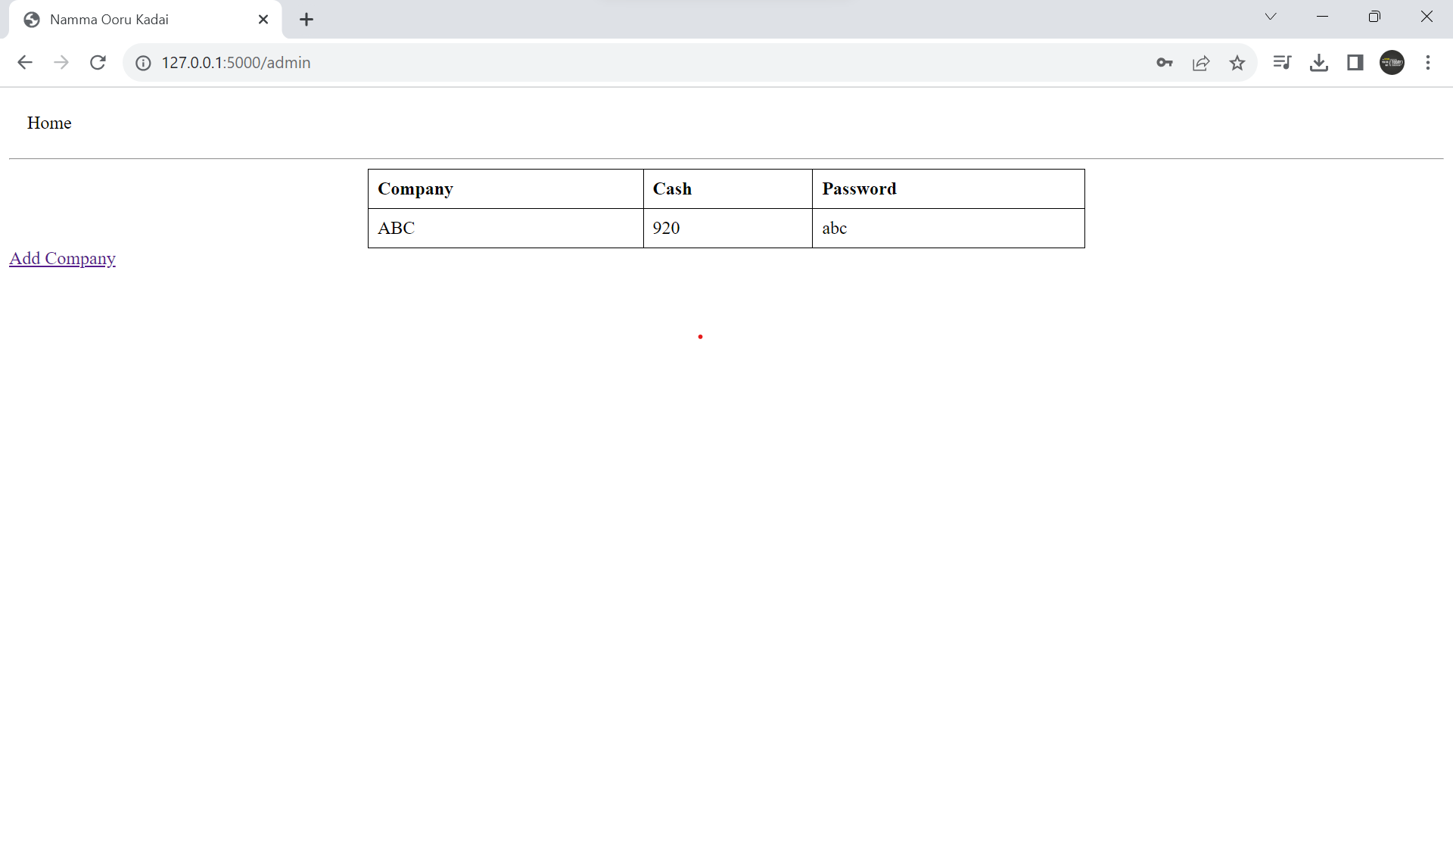
Admin dashboard

Slide 19

Adding company

Slide 20

Thank You
Rethik M
Karpagam institute of technology

